Slide 1

Exploratory Data Analysis

Slide 2

Exploratory Data Analysis
EDA will help you:
Generate questions about your data.
Search for answers by visualising, transforming, and modelling your data.
Use what you learn to refine your questions and/or generate new questions.
It’s an iterative cycle…
Notes:
Use white slides to add pictures

Slide 3
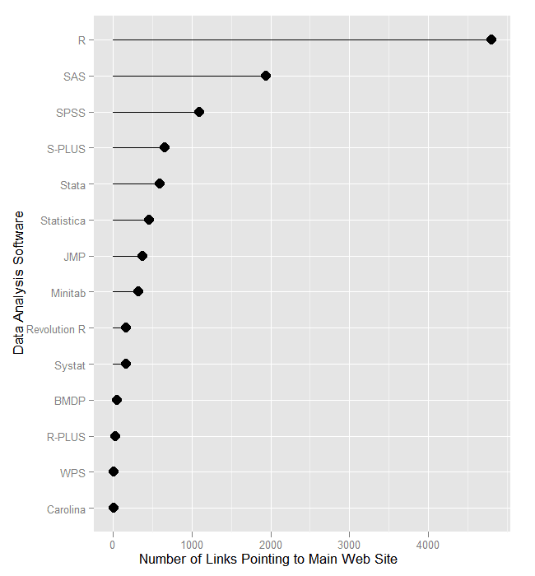
Exploratory Data Analysis
What questions can you generate about the following plot?
Notes:
Use white slides to add pictures

Slide 4
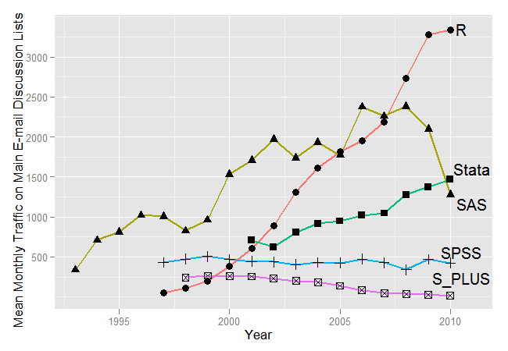
Exploratory Data Analysis
What about this one?
Notes:
Use white slides to add pictures

Slide 5
EDA
Why is EDA so important?
You always need to investigate the quality of your data.
EDA is not a formal process with a strict set of rules.
As your exploration continues, you will home in on a few particularly productive areas that you’ll eventually write up and communicate to others.
Notes:
Use white slides to add pictures

Slide 6
Exploratory Data Analysis
A variable is a quantity, quality, or property that you can measure.
A value is the state of a variable when you measure it and may change from measurement to measurement.
An observation is a set of measurements made under similar conditions; contains several values.
Tabular data is a set of values, each associated with a variable and an observation. Tabular data is tidy if each value is placed in its own “cell”, each variable in its own column, and each observation in its own row.
Notes:
Use white slides to add pictures

Slide 7
Types of Data
Two types of questions will always be useful for making discoveries within your data. You can loosely word these questions as:
What type of variation occurs within my variables?
What type of covariation occurs between my variables?
Notes:
Use white slides to add pictures

Slide 8
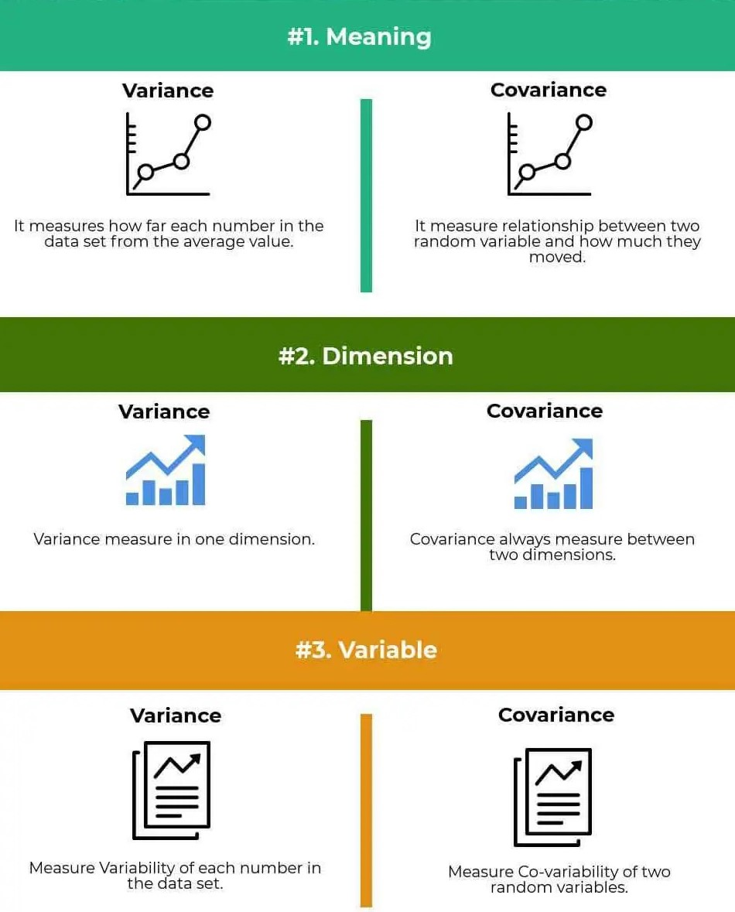
Variance v’s Covariance
Notes:
Use white slides to add pictures

Slide 9
Types of Data
Discrete variables can take only distinct, isolated values, typically whole numbers. They often arise from a counting process:
Shoe size
Year of study
Likert scale (1..5)
Continuous variables can take any value within a sensible range and are normally the result of a measurement process:
Height
Temperature
Distance
Notes:
Use white slides to add pictures

Slide 10
Measures of average
If we could find one measure which tells us about the average of the data set and another which tells us something about how spread out the data set is, then those two measures taken together give us useful information.
There are number of different measures of average.
We shall consider some of the more frequently used including:
Mean
Median
Mode
Notes:
Use white slides to add pictures

Slide 11
Quartiles
Just as the median divides a set of data into two halves with respect to frequency, the quartiles divide the data into quarters.
The middle quartile Q₂ is the median.
The lower quartile Q₁ is defined to be the median of those data values to the left of the median (not including the median).
The upper quartile Q₃ is defined to be the median of those data values to the right of the median (not including the median).
Notes:
Use white slides to add pictures

Slide 12
Variance and standard deviation
Having obtained a measure of location or average for a set of data, we now need an additional measure which gives us an indication of how “spread out” a set of data is.
The two sets of data {9, 10, 11} and {5, 10, 15} each have a mean (and median) of 10.
The distinction between them is the spread of the values within each data set.
We shall examine a number of measures which aim to tell us how closely a set of data is grouped around its mean or median.
Notes:
Use white slides to add pictures

Slide 13
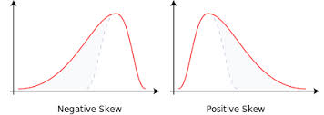
Skewness
This measures how much (or little) symmetry there is in a set of data.
If this curve has a longer tail to the right than to the left, it is said to be skewed to the right, or to have positive skewness.
Conversely, if the curve has a longer tail to the left than to the right, it is said to be skewed to the left, or to have negative skewness.
Notes:
Use white slides to add pictures

Slide 14
The importance of visualisation
Summary statistics indeed help us understand the data but will never reveal everything of it.
Relying solely on summary statistics such as mean, variance and correlation, can make you miss the bigger picture.
Anscombe's quartet comprises four data sets. Each dataset consists of eleven (x,y) points.
When analsyed they have nearly identical simple descriptive statistics, yet have very different distributions and appear very different when graphed.
Notes:
Use white slides to add pictures

Slide 15
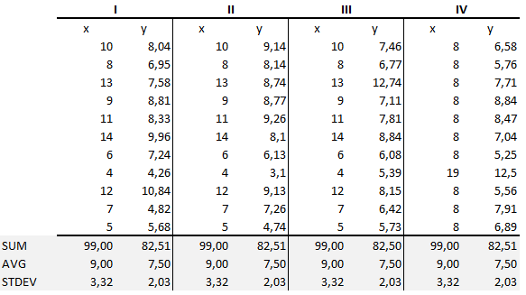
The importance of visualisation
Notes:
Use white slides to add pictures

Slide 16
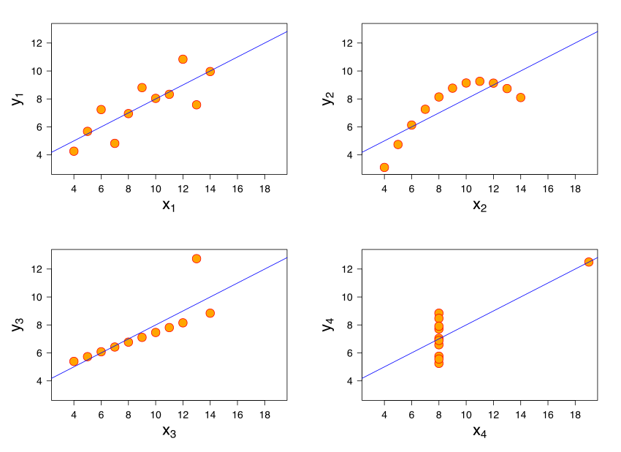
The importance of visualisation
Notes:
Use white slides to add pictures

Slide 17
DatasauRus
The Datasaurus dataset was initially created by Alberto Cairo. It is composed of 142 observations with a bivariate normal distribution.
Inspired by this example, two researchers at Autodesk Research, Justin Matejka and George Fitzmaurice, created another twelve similar datasets.
The x and y variables represent the coordinates of each observation. The dataset variable represent a name to establish which group every point belongs to.
Notes:
Use white slides to add pictures

Slide 18
DatasauRus
 | dataset | x | y
0 | dino | 55.384600 | 97.179500
1 | dino | 51.538500 | 96.025600
2 | dino | 46.153800 | 94.487200
3 | dino | 42.820500 | 91.410300
4 | dino | 40.769200 | 88.333300
... | ... | ... | ...
1841 | wide_lines | 33.674442 | 26.090490
1842 | wide_lines | 75.627255 | 37.128752
1843 | wide_lines | 40.610125 | 89.136240
1844 | wide_lines | 39.114366 | 96.481751
1845 | wide_lines | 34.583829 | 89.588902
Notes:
Use white slides to add pictures

Slide 19
DatasauRus
 | x |  |  | y
dataset | count | mean | std | count | mean | std
away | 142 | 54.266100 | 16.769825 | 142 | 47.834721 | 26.939743
bullseye | 142 | 54.268730 | 16.769239 | 142 | 47.830823 | 26.935727
circle | 142 | 54.267320 | 16.760013 | 142 | 47.837717 | 26.930036
dino | 142 | 54.263273 | 16.765142 | 142 | 47.832253 | 26.935403
dots | 142 | 54.260303 | 16.767735 | 142 | 47.839829 | 26.930192
h_lines | 142 | 54.261442 | 16.765898 | 142 | 47.830252 | 26.939876
high_lines | 142 | 54.268805 | 16.766704 | 142 | 47.835450 | 26.939998
slant_down | 142 | 54.267849 | 16.766759 | 142 | 47.835896 | 26.936105
slant_up | 142 | 54.265882 | 16.768853 | 142 | 47.831496 | 26.938608
star | 142 | 54.267341 | 16.768959 | 142 | 47.839545 | 26.930275
v_lines | 142 | 54.269927 | 16.769959 | 142 | 47.836988 | 26.937684
wide_lines | 142 | 54.266916 | 16.770000 | 142 | 47.831602 | 26.937902
x_shape | 142 | 54.260150 | 16.769958 | 142 | 47.839717 | 26.930002
Notes:
Use white slides to add pictures

Slide 20
DatasauRus
It seems, that all the 13 different groups share very similar values for mean and standard deviation for both variables.
But what happens if we plot these points, drawing one plot for each group?
Notes:
Use white slides to add pictures

Slide 21
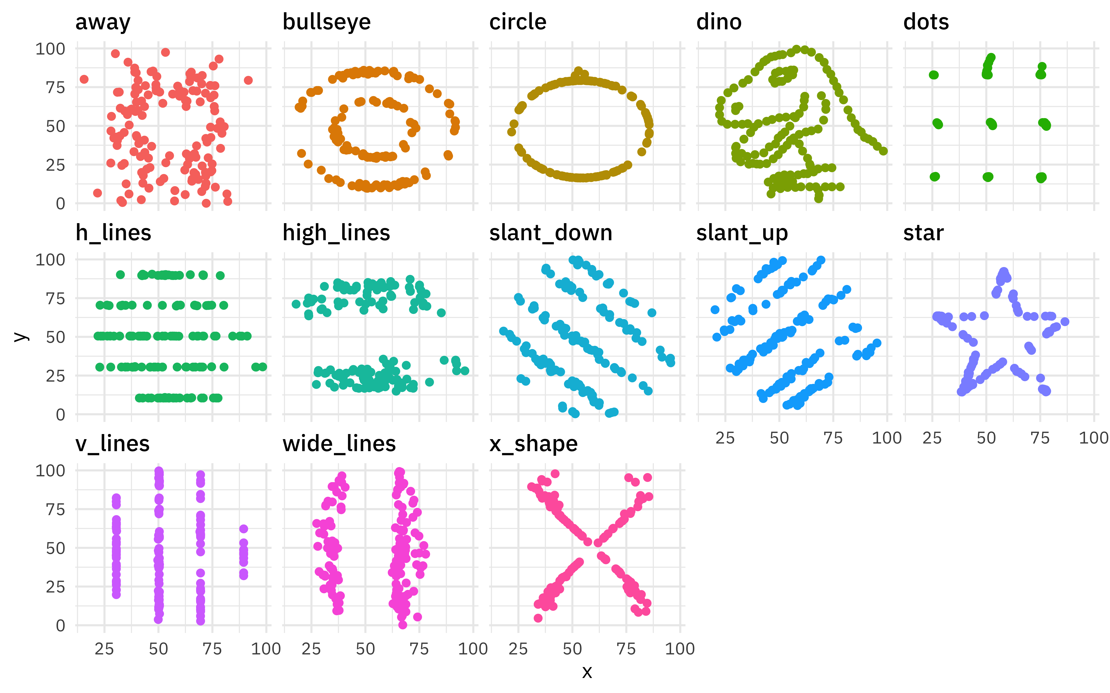
DatasauRus
Notes:
Use white slides to add pictures

Slide 22
DatasauRus
Notes:
Use white slides to add pictures

Slide 23
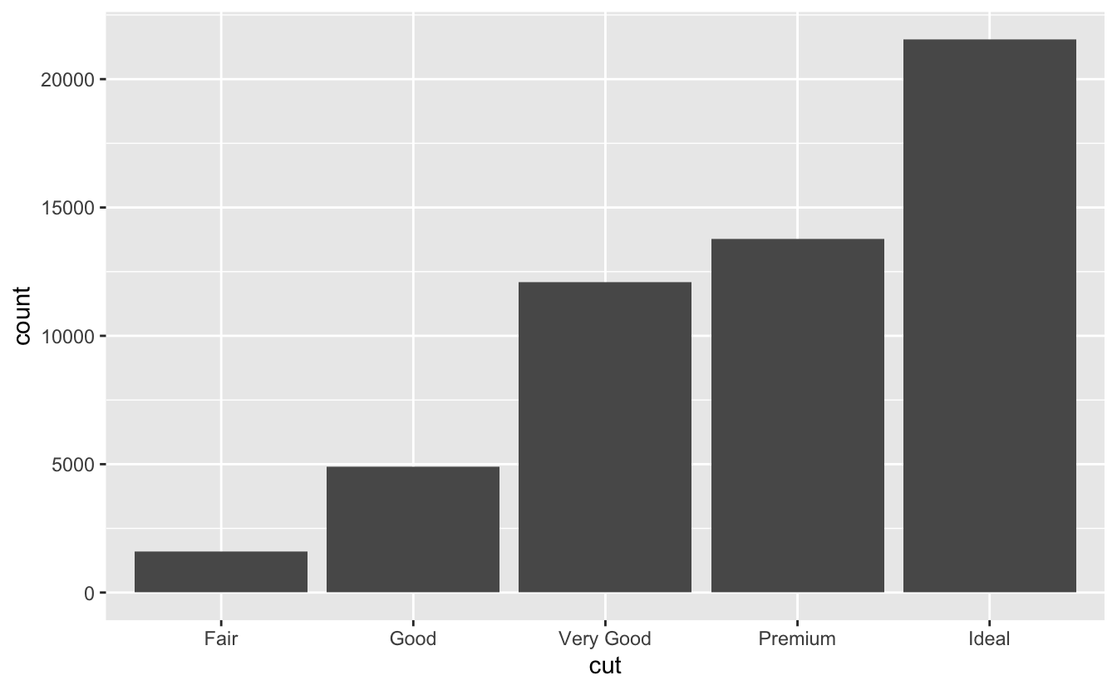
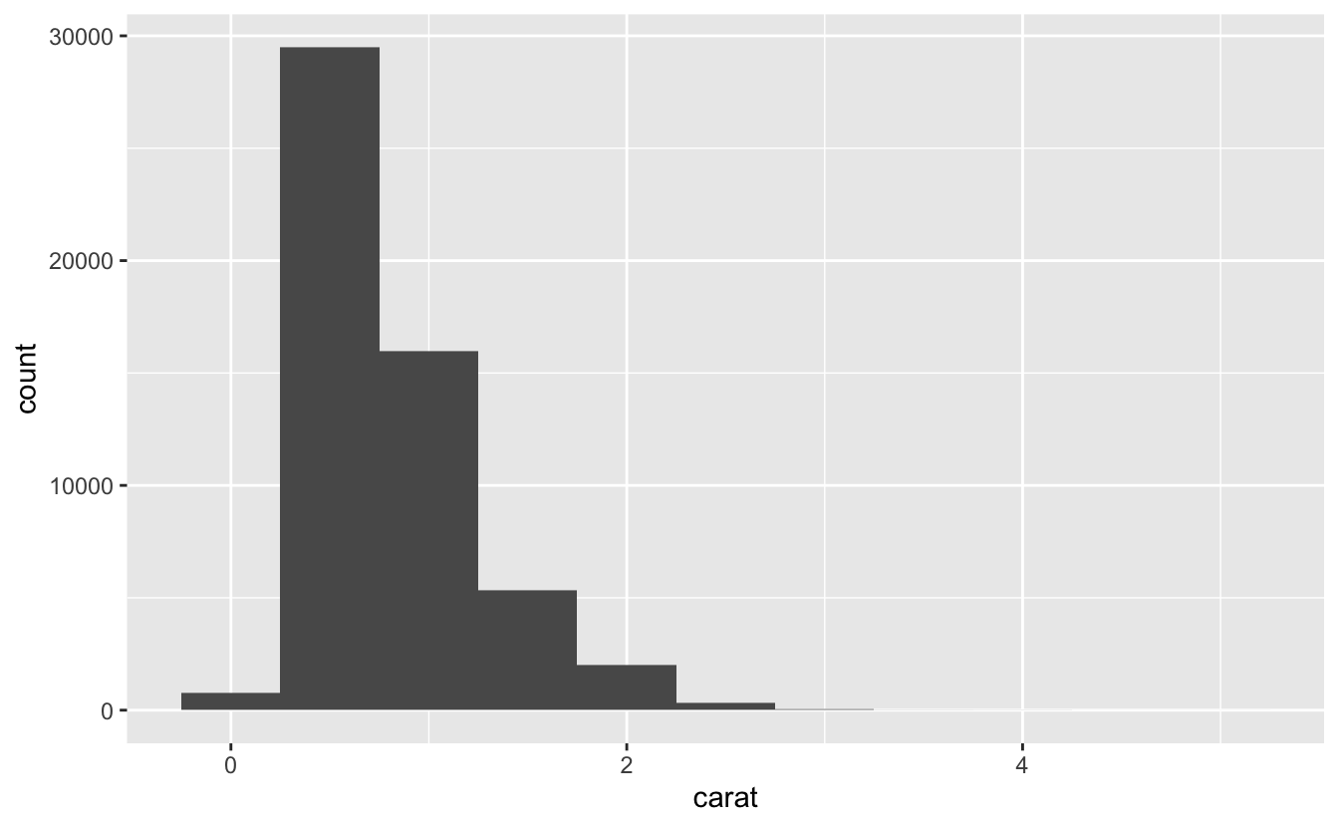
Example
diamonds data
A dataset containing the prices and other attributes of almost 54,000 diamonds.
Notes:
Use white slides to add pictures

Slide 24
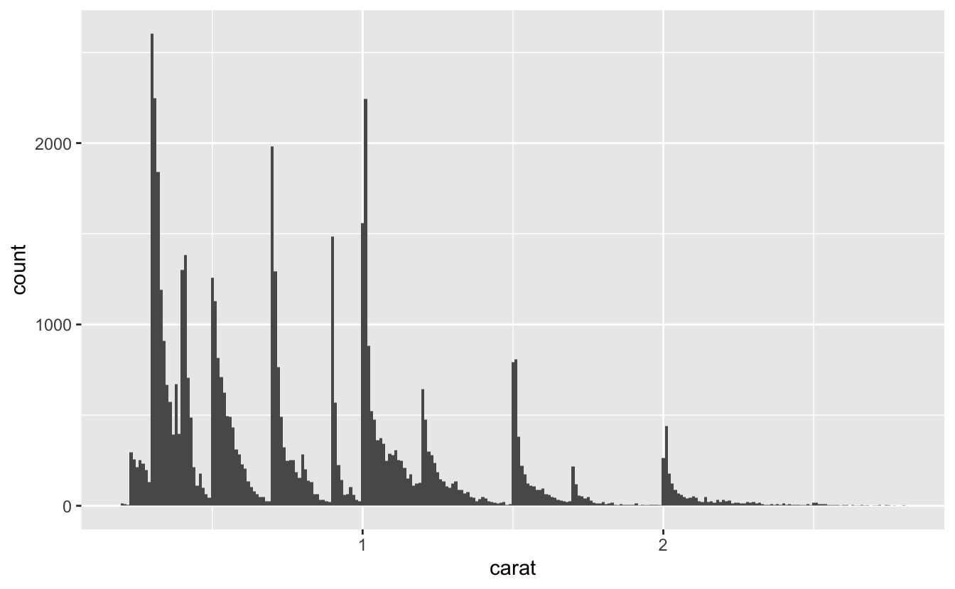
Example
You should always explore a variety of binwidths when working with histograms, as different binwidths can reveal different patterns.
Notes:
Use white slides to add pictures

Slide 25
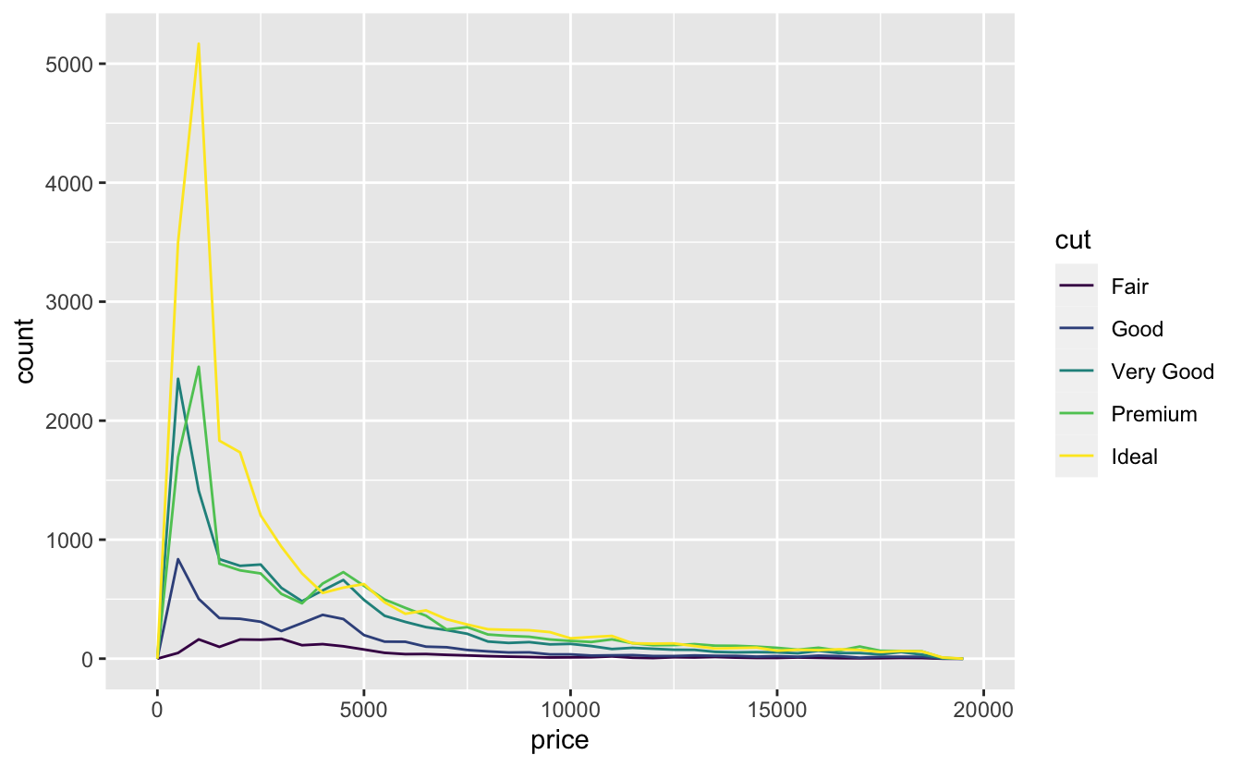
Example
What should you look for in your plots?
What follow up questions should you ask?
Which values are the most common? Why?
Notes:
Use white slides to add pictures

Slide 26
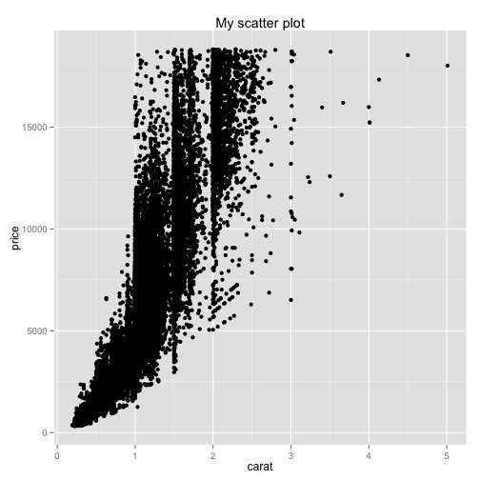
Example
Clusters of similar values suggest that subgroups exist in your data.
How can you explain or describe the clusters?
Why might the appearance of clusters be misleading?
Notes:
Use white slides to add pictures

Slide 27
Next steps
R read Chapter 2 of statistics in R course
Python read Chapter 1 of statistics in Python course
Datasaurus Dozen
Diamonds | Kaggle
1. Exploratory Data Analysis - Practical Statistics for Data Scientists [Book] (oreilly.com)
Notes:
Use white slides to add pictures

Slide 28

Questions?
Notes:
Use white slides to add pictures

